Slide 1
Proposed Network For A school
DCN 17.1 Group 03

Slide 2
Our Goals
To give a better network infrastructure for the institute
To use best equipment according to a well managed budget
To provide faster internet connection through both wired and wireless media
Implement IoT devices.
Provide the best security for the Network.

Slide 3
Features of The Network
This network will be designed for make connectivity among the all users in the School Area.
The Network operational from inside the server room.
Divided into VLANs for reduce memory, network usage and for improved security of the networks and devices.
All users can access internet with some rules. Filtering will be depending on his or her user ID.
There are Wi-Fi area which covers entire school and guests and minor staff can access to the internet through their own devices.
There are one main internet connection and another backup line.
Firewall will be protecting the network from the harmful traffic and block unauthorized accesses.

Slide 4
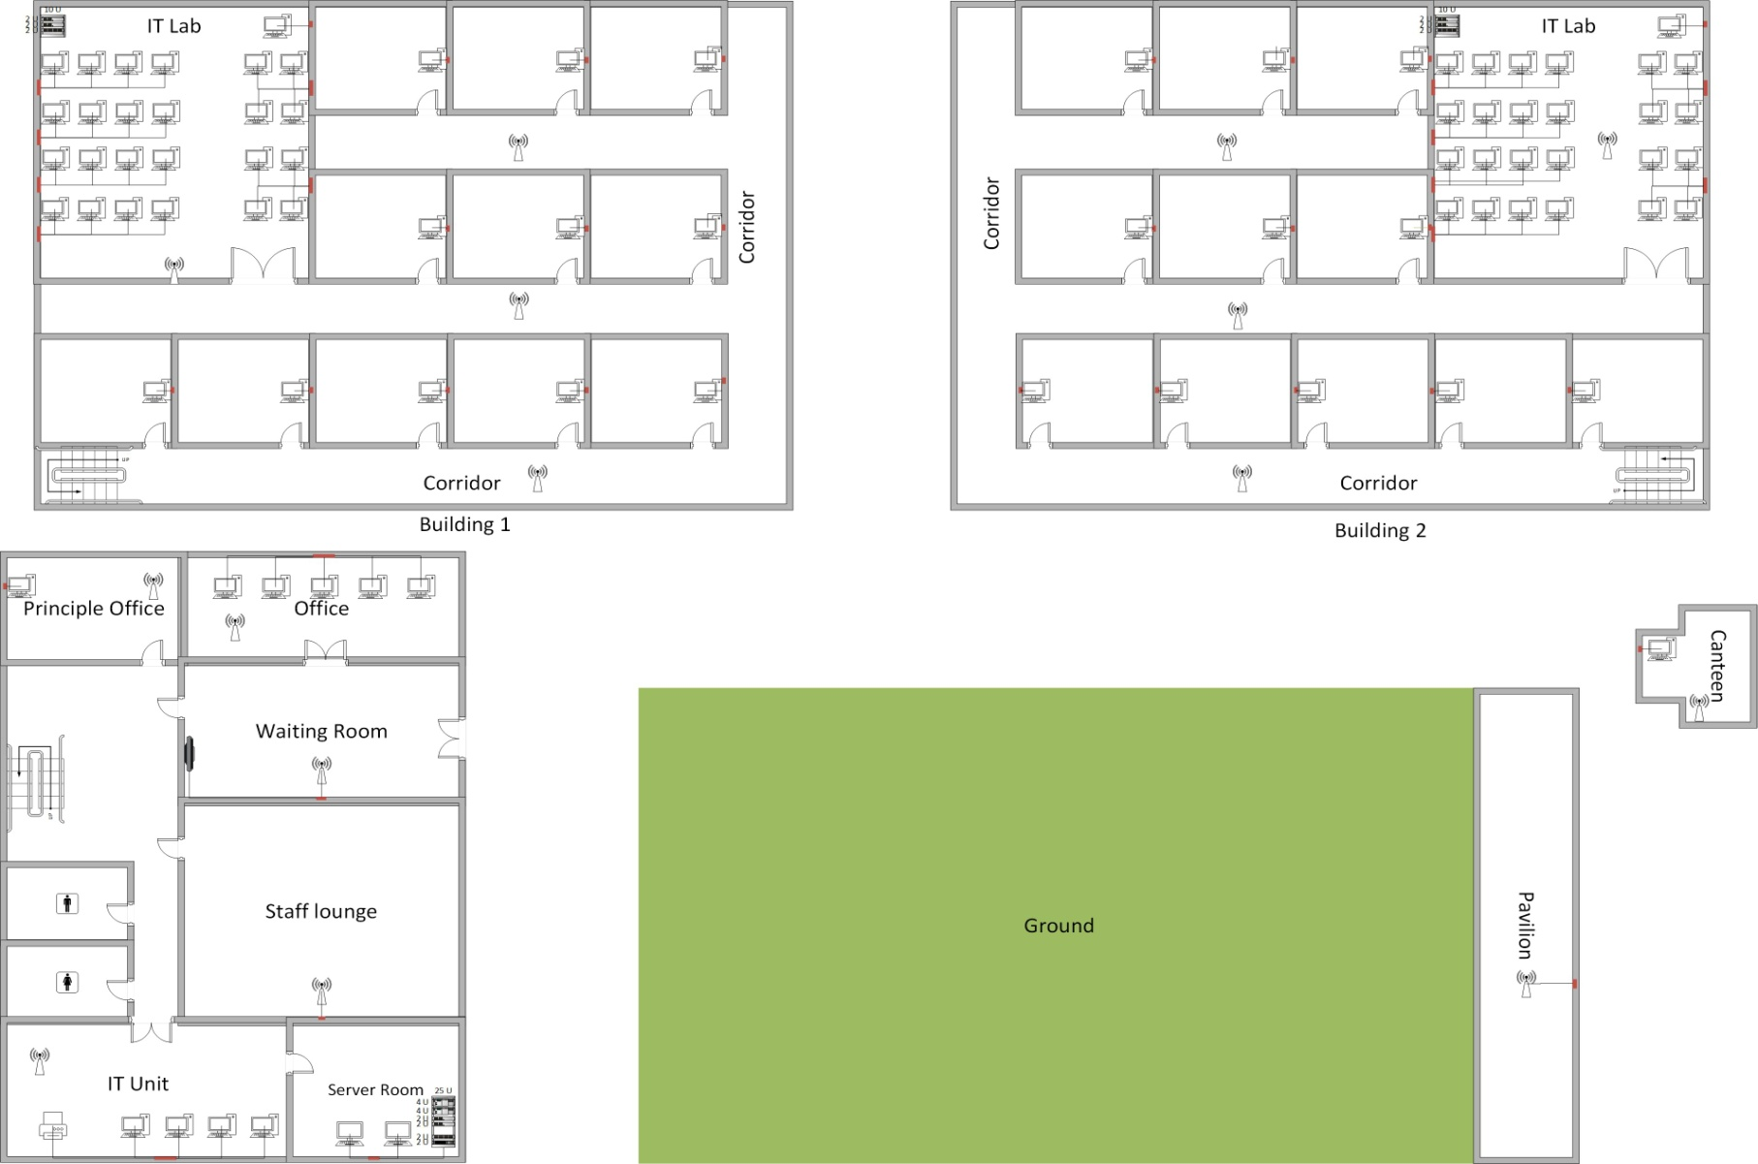
Ground FLOOR

Slide 5
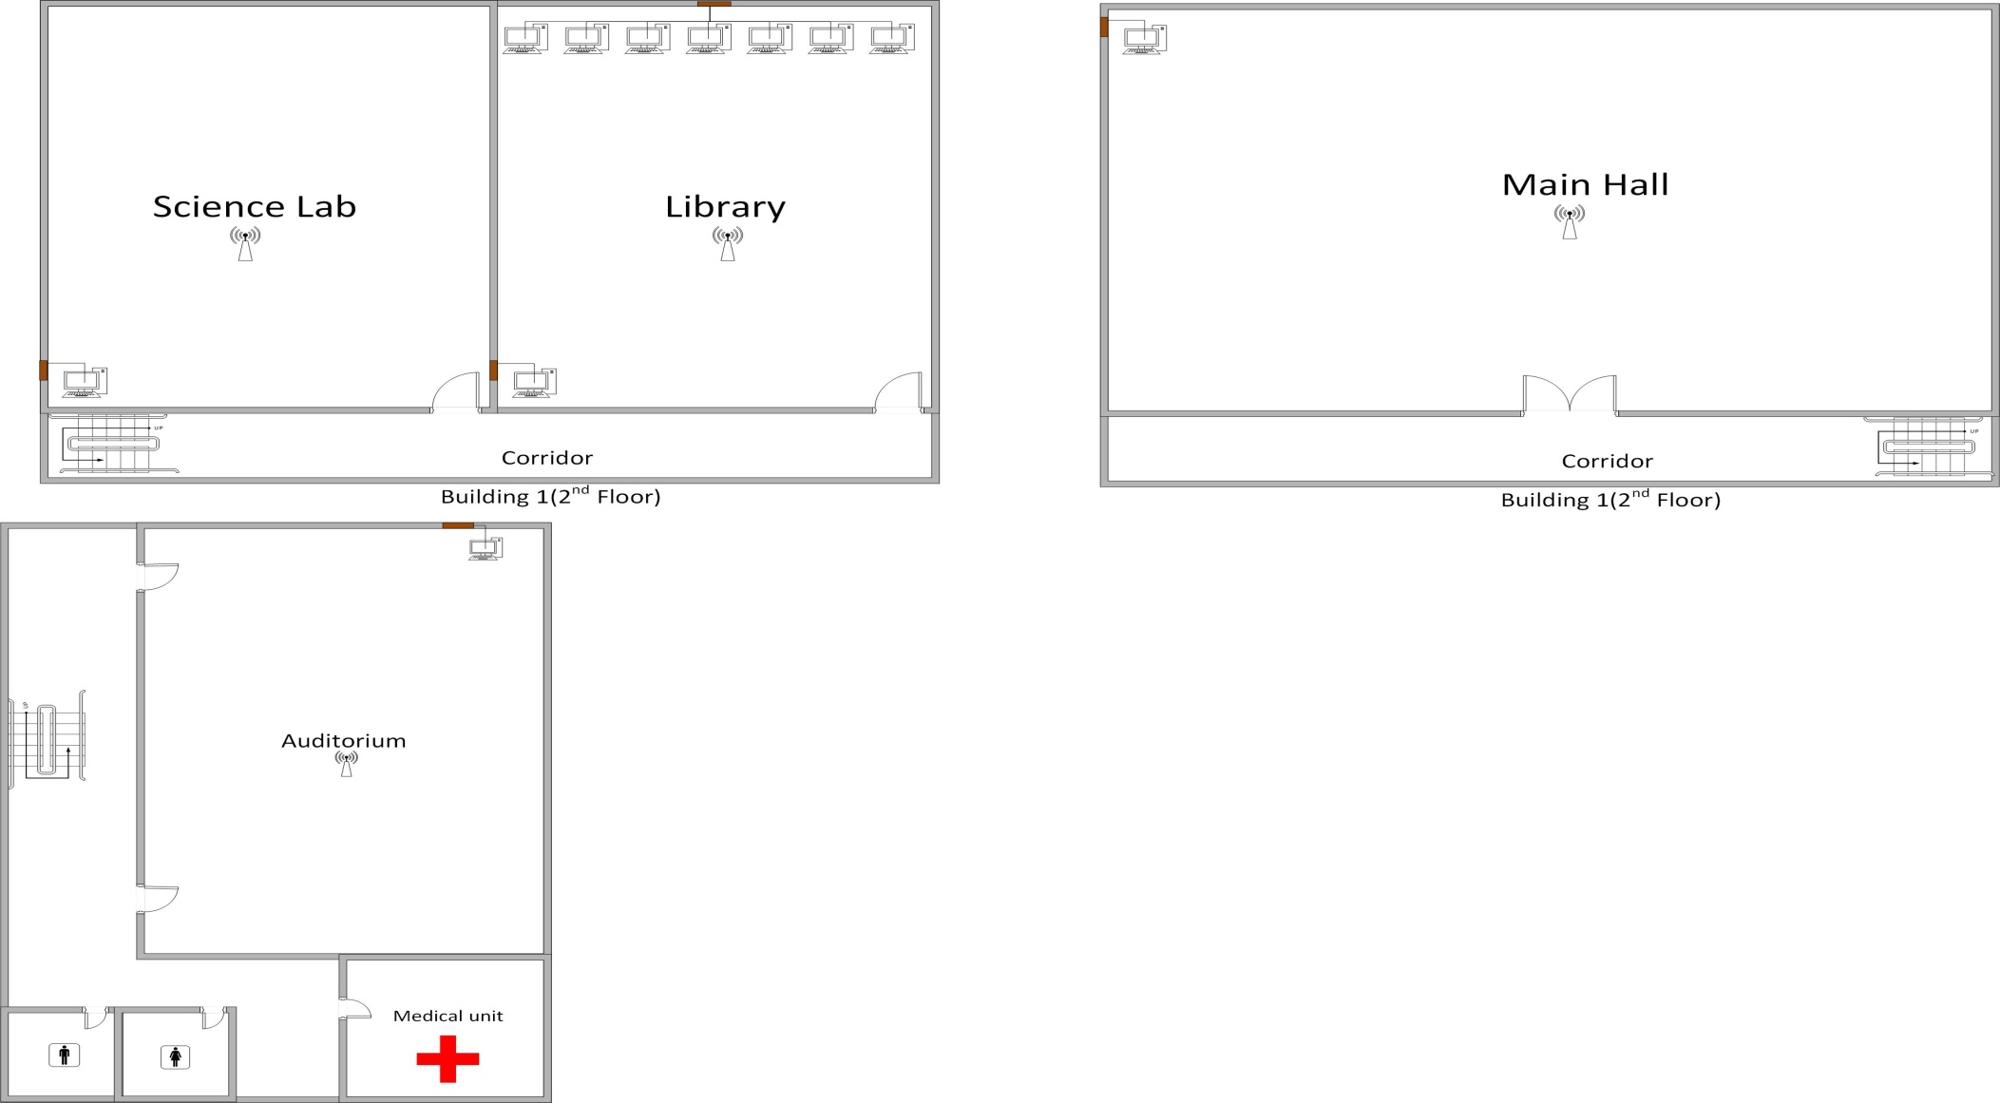
fIRST FLOOR

Slide 6
Office Building Details
VLANs
IT Unit
Office
Principle Office
Auditorium
Devices
5 AP
30 Wall Sockets
24 Port switch
Server room
Leased line Dialog
Leased line Dialog (Backup)
2x Firewall
2 x Cisco Catalyst 3650 core switch
Dell PowerEdge T20 Server machine

Slide 7
Building 1 details
VLANS
IT Lab
Classes
Science Lab
Library
Devices
7 x AP
2 x 24 Port switch
50 x wall sockets
10u Wall rack
48 port patch panel

Slide 8
Building 2 details
VLANS
IT Lab 2
Classes
Main Hall
Canteen
Devices
6 x AP
2 x 24 Port switch
50 x Wall sockets
10U Wall Rack
48 port patch panel

Slide 9
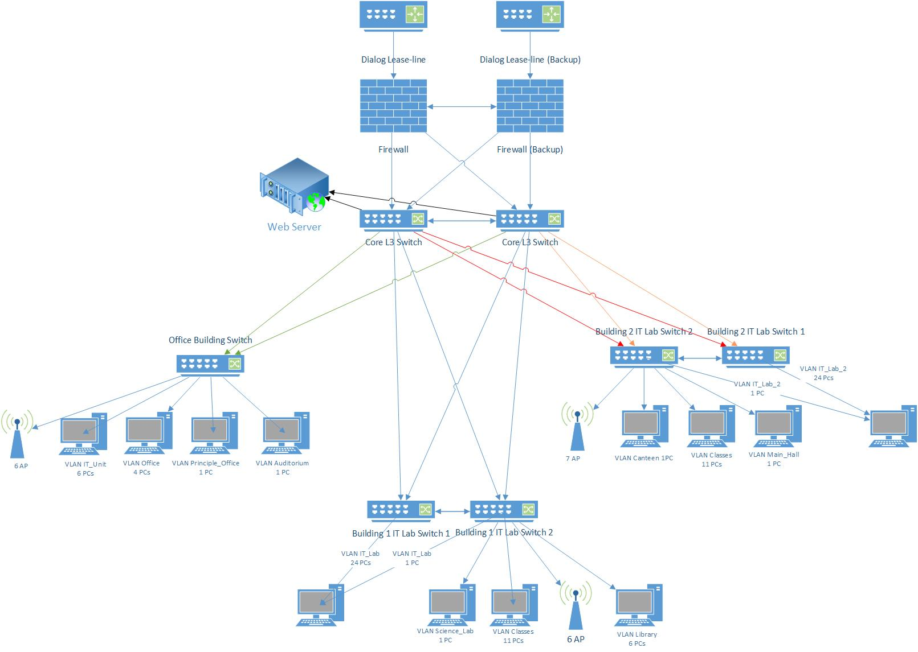
Network Topology

Slide 10
Estimated Budget
Name | Price | Quantity | Total
Cisco Catalyst 2960-L Series 24 Port | Rs.108447 | 5 | Rs.542235
Cisco Catalyst 3650 24 Port | Rs.244982 | 2 | Rs.489964
Cisco Aironet 1815i Wireless Access Point | Rs.40227 | 20 | Rs.804540
Cisco ASA 5500-X Firewall | Rs.478,842 | 2 | Rs.957684
Cat6 Ethernet cable roll (1000ft) | Rs.9000 | 10 | Rs.90000
Fiber Optic Cable (1000ft) | Rs.24810 | 4 | Rs.99240
Rack 36U | Rs.70329 | 1 | Rs.70329
10U Wall Mount Rack | Rs.48275 | 2 | Rs.96550
CAT 6 Faceplate socket | Rs.400 | 120 | Rs.48000
48 Port Patch panel | Rs.10454 | 2 | Rs.20908
Lease-line Dialog | Rs.180000 | 2 | Rs.360000
Grand Total |  |  | Rs.3,579,450

Slide 11
THANK YOU

